Slide 1
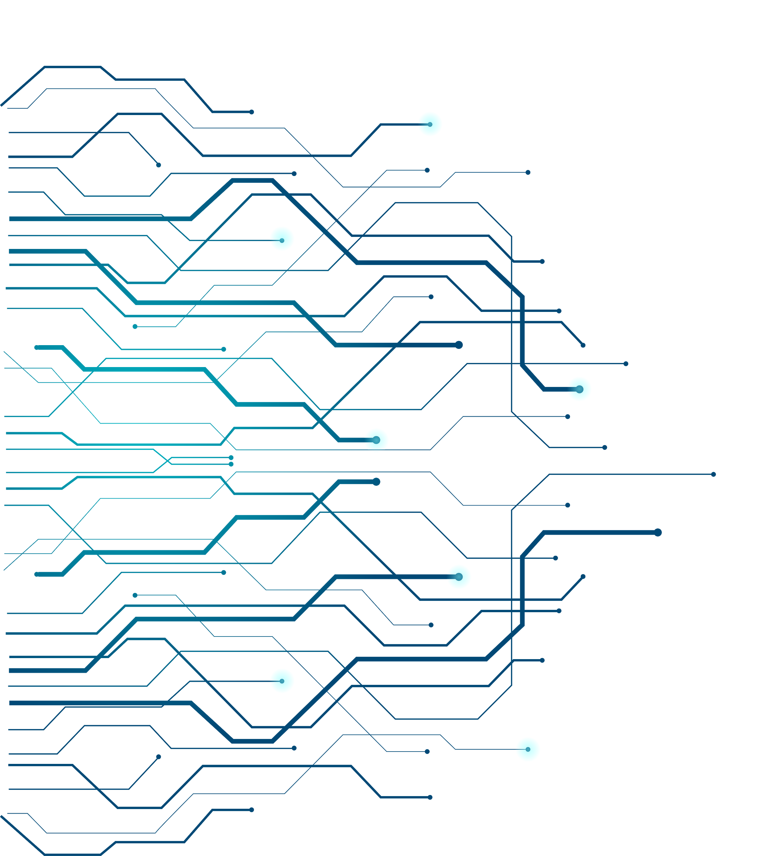
Spherical Histogram Approximation for Maximum Flow of Brain Connectivity
Lanston Hau Man Chu
University of Wisconsin-Madison

Slide 2
Contents
🠺
🠺
Motivation and background
Method
Result

Slide 3
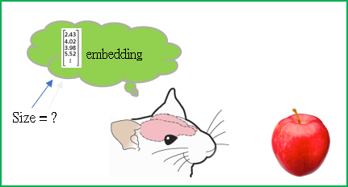
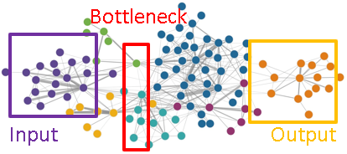
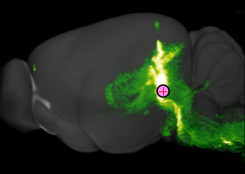
Motivation
T
🠺
🠺
Channel size of perception ← can be determined in psychological experiments.
Knowledge representation: Size of embedding → the channel size
Autoencoder in Deep Learning: Bottleneck between encoder and decoder refers to embedding
Neural activities: Bottleneck, or maximum flow areas ← refers to psychological embedding?
Want to determine the maximum flow areas!

Slide 4
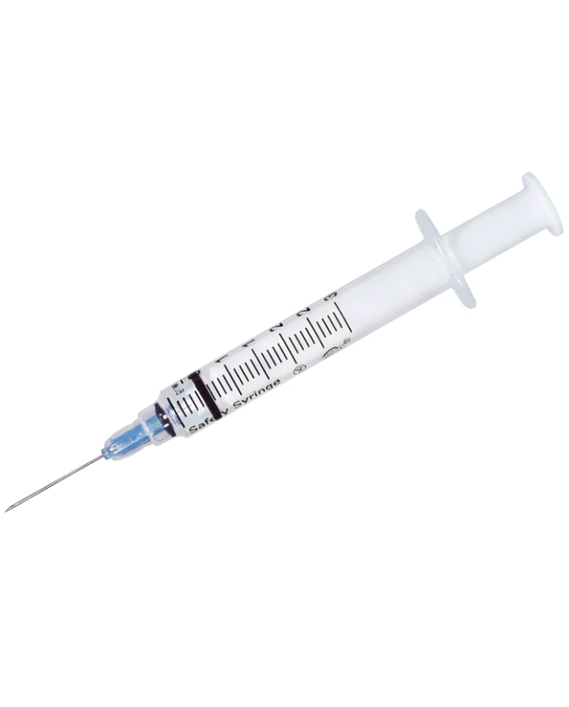
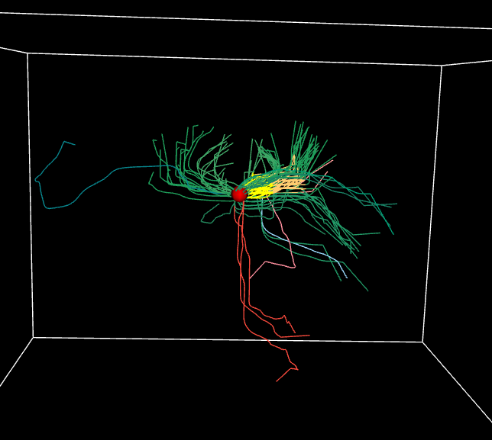

Background
T
🠺
🠺
Brain connectivity experiments: Injection of fluorescent virus (e.g. rAAV)
By Allen Institute since 2010s
Intensity/Density values would be obtained by 3D scan of a mouse brain after injection
Diffusion graph $G$ can be constructed by Fast Matching Method (Sethian, 1999) ← Derived from the gradient of intensity values
Note: Retrograde graph

Slide 5
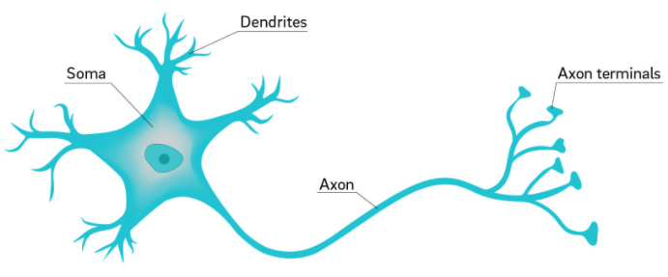
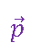
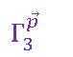
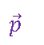
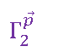
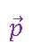
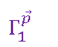
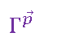


Method
T
Neuron
Anterograde
🠺
🠺
Anterograde vs. Retrograde
rAAV used in injection experiments are anterograde
We are interested in retrograde perspective: How specific destination site is affected by source?
Form a combined graph using all paths pointing a specific destination $\vec{p}$ = (x, y, z)
Retrograde
$$Γ_{1}^{\vec{p}}$$
$$Γ_{2}^{\vec{p}}$$
$$Γ_{3}^{\vec{p}}$$
$$\vec{p}$$
$$\vec{p}$$
$$\vec{p}$$
Experiment 1
Experiment 2
Experiment 3
$$Γ^{\vec{p}}= \bigcup_{i}{ Γ_{j}^{\vec{p}}}$$
$$Γ^{\vec{p}}$$
$$\vec{p}$$
Combined Graph
(Retrograde)

Slide 6
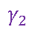
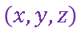
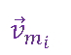
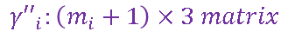
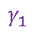
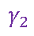
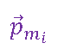
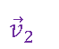
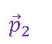
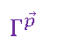
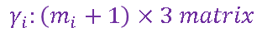
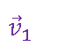

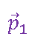
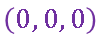
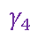


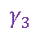
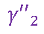
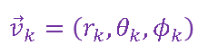
Method
T
$$Γ^{\vec{p}}$$
$$γ_{2}$$
$$γ_{3}$$
$$γ_{1}$$
$$\vec{p}$$
$$γ_{4}$$
Given graph G = (V, Γ), each path $γ_{i}∈Γ$ is a $\left(m_{i}+1\right)×3$ matrix
Recentered: ${γ′}_{i}=γ_{i}−\vec{p}$
Spherical Coordinate:
$${\vec{p}}_{2}$$
$${\vec{p}}_{1}$$
$$γ_{2}$$
$$\vec{p}$$
$$=$$
$$…$$
$$\left(x, y, z\right)$$
$${\vec{p}}_{m_{i}}$$
$${\vec{v}}_{k}=\left(r_{k},θ_{k},φ_{k}\right)$$
$$=(\sqrt{x_{k}^{′2},y_{k}^{′2},z_{k}^{′2}}, arccos(\frac{{z′}_{k}}{r_{k}}),arctan(\frac{{z′}_{k}}{{x′}_{k}}))$$
$$γ_{i}:\left(m_{i}+1\right)×3 matrix$$
$${\vec{v}}_{2}$$
$${\vec{v}}_{1}$$
$${γ′′}_{2}$$
$$…$$
$$\left(0, 0, 0\right)$$
$${\vec{v}}_{m_{i}}$$
$${\vec{v}}_{k}=\left(r_{k},θ_{k},φ_{k}\right)$$
$${γ′′}_{i}:\left(m_{i}+1\right)×3 matrix$$

Slide 7
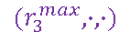
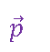
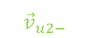


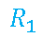
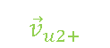
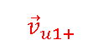
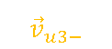
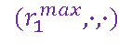

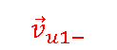

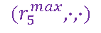
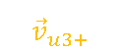

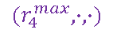


Method
T
$${(r}_{5}^{max},∙,∙)$$
$${(r}_{1}^{max},∙,∙)$$
$$R_{1}$$
$$R_{0}$$
$${(r}_{2}^{max},∙,∙)$$
$$\vec{p}$$
$${(r}_{3}^{max},∙,∙)$$
Construct walls of specific radius to capture maximum flow
$${(r}_{4}^{max},∙,∙)$$
$$r_{0.75}=percentile(\{r_{1}^{max},...,r_{n}^{max}\}, 75\%)$$
$$(R_{0}, R_{1}, R_{2}, …) = (0.3 r_{0.75}, 0.6r_{0.75}, 0.9 r_{0.75}, …)$$
$$R_{u}$$
$${\vec{v}}_{u1+}$$
$${\vec{v}}_{u1−}$$
$$\vec{p}$$
$${\vec{v}}_{u2+}$$
$${\vec{v}}_{u2−}$$
$${\vec{v}}_{u3+}$$
$${\vec{v}}_{u3−}$$
Walls hitting points ${\vec{v}}_{uk±}$ : Closest to walls ← For doing Spherical Histogram
$$θ$$
$$φ$$

Slide 8
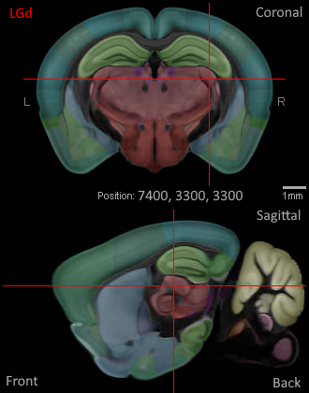
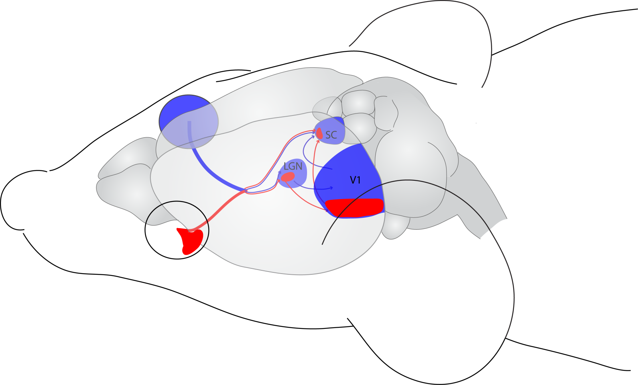
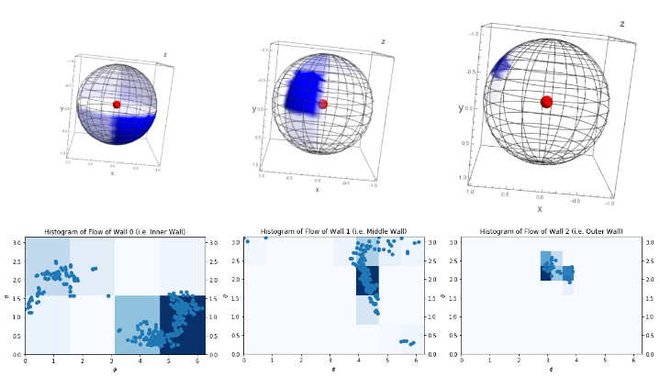
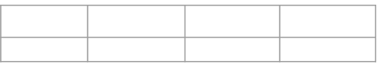

Result
T
Wall radii | $$R_{0}$$ | $$R_{1}$$ | $$R_{2}$$
Value | 886μm | 1773μm | 2659μm
Taking a point in LGd as destination site $\vec{p}$
LGd (Dorsal part of the lateral geniculate complex) ← key intermediary point of the visual system
Obtained spherical histogram result for wall hitting points at LGd
Maximum flow areas captured the wall hitting points
Brain-containing cuboid size: 13200μm × 8000μm × 11400μm

Slide 9
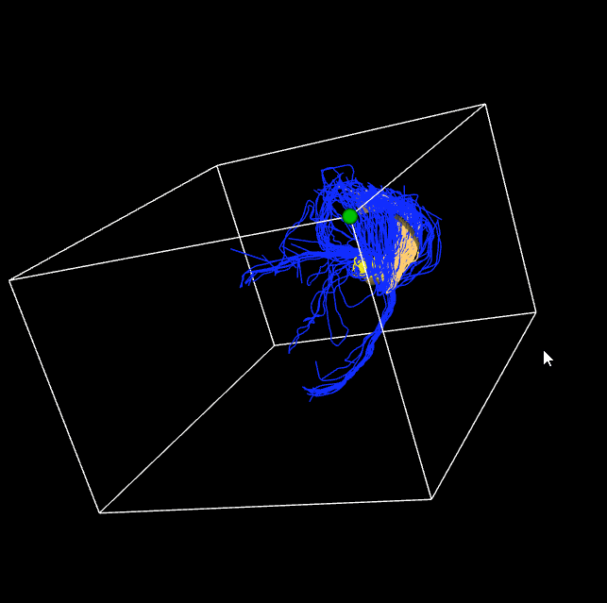
Result
T
Place the maximum flow area in the 3D space
Red dot: destination site
Colored areas: maximum flow area
Colored lines: lines passing through the maximum flow area
The sub-regions with densest flows are captured

Slide 10
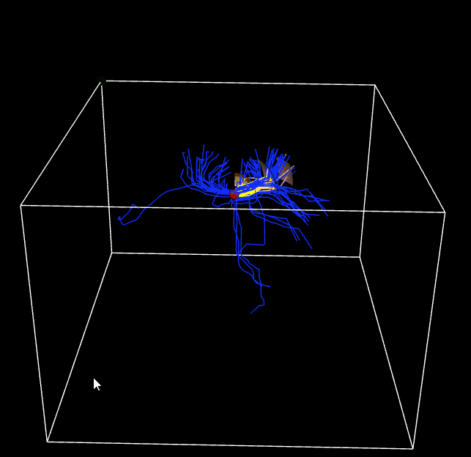



Result
T
CC
Another destination site $\vec{p}$ at IG (Innduseum Griseum).
The maximum flow area is roughly along the CC (Corpus Callosum) ← Axons rich region in brain

Slide 11



Result
T
Destination site $\vec{p}$ at MO1 (Somatomotor areas, Layer 1).
The maximum flow area is roughly along the cortex

Slide 12


Result
T
Spherical Clustering: Alternative of Spherical Histogram
Simply apply Euclidean distance to $(θ,φ)$ ← can be improved
Try different #(clusters) until Silhouette score is maximized

Slide 13


Discussion
T
Future improvement 1: Bin merging
Future improvement 2: More sophisticated function on $(θ,φ)$ → considering spherical topology

Slide 14


Summary
T
Spherical Histogram efficiently captured maximum flow area: $O(\left|Γ\right|)$ for spherical histogram or $O(\left|Γ\right|{|𝕂|}^{2})$ for spherical clustering.
Future study on maximum flow areas may connects to perception channel capacity of computational cognitive science and embedding analysis of machine learning.

Slide 15
References
T
Allen Institute for Brain Science. (2017). Allen Mouse Brain Connectivity Atlas : Technical White Paper : Overview. Technical White Paper, (March), 1–15.
Bates, C. J., Lerch, R. A., Sims, C. R., &Jacobs, R. A. (2019). Adaptive allocation of human visual working memory capacity during statistical and categorical learning. Journal of Vision, 19(2), 1–23. https://doi.org/10.1167/19.2.11
Sethian, J. A. (1999). Fast Marching Methods. SIAM Review, 41(2), 199–235. https://doi.org/10.1137/S0036144598347059
Sims, C. R. (2016). Rate-distortion theory and human perception. Cognition, 152,

Slide 16


Thanks!
T
🠺
🠺
Do you have any questions? hchu34@wisc.edu
University of Wisconsin-Madison
https://lanstonchu.wordpress.com/

